Slide 1
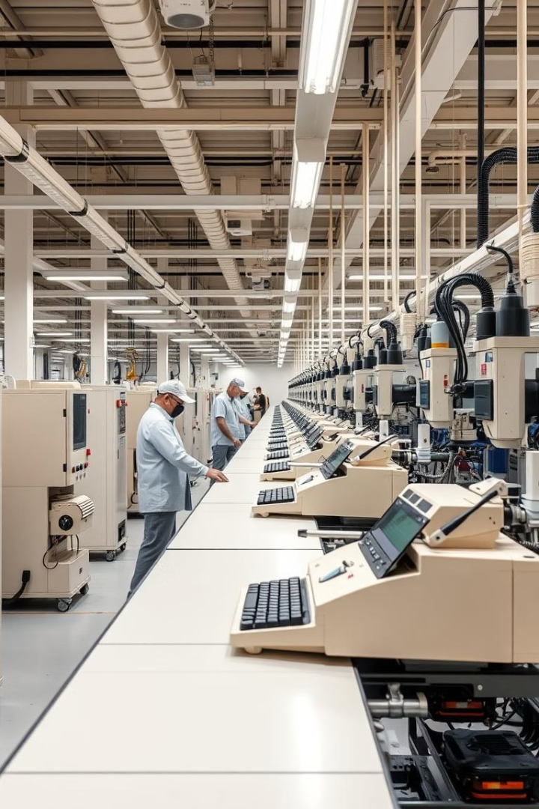
Project Name Manufacturing Downtime
This project brought by:
Elshimaa hamdeno Abdelkader
Karim kilany
Analysis using power pi

Slide 2
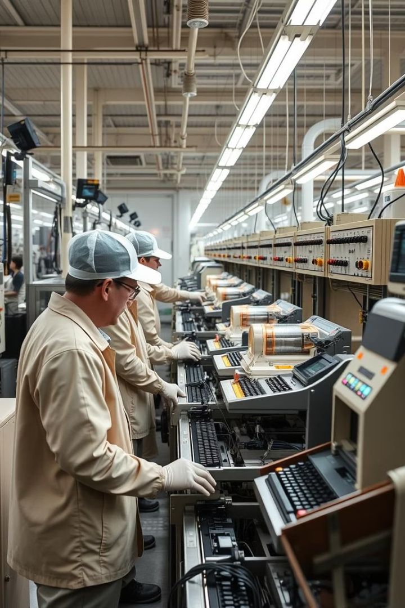




Case Study Overview
Production Start
Line operators determine the start time for batch production
Product Details
Recording product details such as flavour and size
Efficiency Tracking
Production efficiency is tracked by analysing the downtimes associated with each batch
Downtime Factors
Downtime can occur due to various factors, such as operator errors or equipment malfunctions
The production process in the factory involves several stages, starting from the beginning of batch production to its completion. Initially, the line operators determine the start time for batch production, recording product details such as flavour and size. Production efficiency is tracked by analysing the downtimes associated with each batch. Downtime can occur due to various factors, such as operator errors or equipment malfunctions.

Slide 3


Downtime Analysis
Downtime Recording
Impact on Productivity
These downtimes are recorded in a separate table containing a unique ID for each downtime factor, along with a description of the factor and whether it was caused by operator error (Yes/No).
Downtime significantly affects the overall productivity of the line. When downtime is caused by operator errors, it leads to greater delays and reduced production.
Power BI Solution
We will work on analysing and improving this process using Power BI to track and visualize the data more effectively.

Slide 4










Key Performance Indicators
Min Batch Time
Minimum time required to complete a production batch
Real Production Time
Downtime
Actual time spent in active production
Total time lost due to production interruptions
Downtime %
Production per Operator
Percentage of total time spent in downtime
Output metrics for individual operators
Production Time per Batch
Downtime per Operator
Time required to complete each production batch
Downtime attributed to each operator
Errors Frequency
Actual Time Productivity
Rate of occurrence of different types of errors
Productivity measured against actual production time
Downtime per Batch
Actual Time %
Downtime occurring in each production batch
Productivity measured against actual time %

Slide 5

Project Roles and Responsibilities
Area
Elshimaa hamdeno Abdelkader
Karim kilany
PowerPoint
Content
PowerPoint design
Data Cleaning
Tables: downtime factors, line downtime, line productivity
Tables: product, Recommendations
DAX Measures
Actual time productivity, Downtime per batch, downtime per operator, ERRORS FREQUENCY, Downtime, Downtime %, Min batch time
production per operator, Production Time per Batch, real production time
Dashboard
overview, downtime, operator details, Design
productivity, Recommendations, product details

